Slide 1
Ransomware
Presented By-
Omkar Savant - SEIT

Slide 2

INTRODUCTION
Ransomware is a type of malware from cryptovirology that threatens to publish the victim's data or perpetually block access to it unless a ransom is paid.
The earliest variants of ransomware were developed in the late 1980s, and payment was to be sent via snail mail.
Today, ransomware authors order that payment be sent via cryptocurrency or credit card.

Slide 3
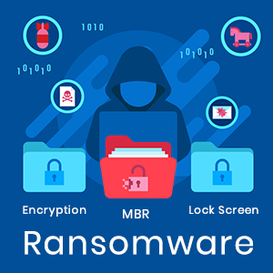
Ransomware
Ransomware is taking from words Ransom and Malware.
Ransomware is a form of malware that encrypts a victim's files. The attacker then demands a ransom from the victim to restore access to the data upon payment.
Users are shown instructions for how to pay a fee to get the decryption key.
The costs can range from a few hundred dollars to thousands, payable to cybercriminals in Bitcoin.

Slide 4
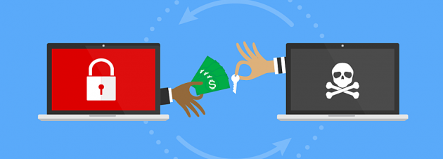
Ransomware

Slide 5

History
The AIDS Trojan, also known as the PC Cyborg virus, was the first ever ransomware virus documented.
It was created by Joseph Popp in 1989.
It was released via floppy disk before most of us ever had the opportunity to touch a computer in 1989.
It nearly affected 20,000 infected disks of attendees of the World Health Organization’s AIDS conference.

Slide 6

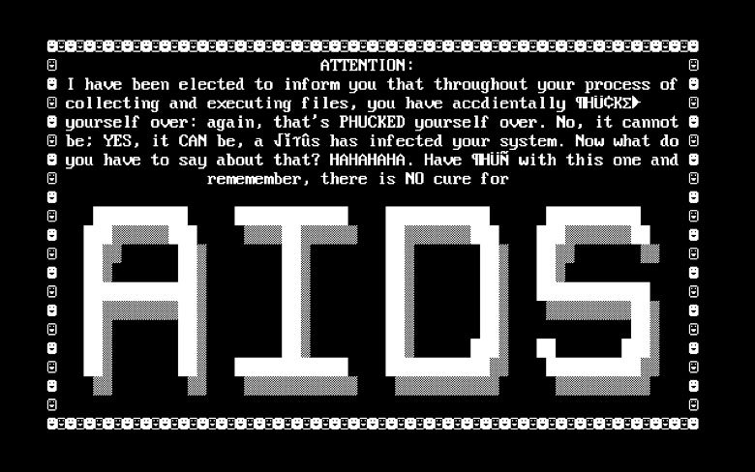
Joseph Popp AIDS

Slide 7
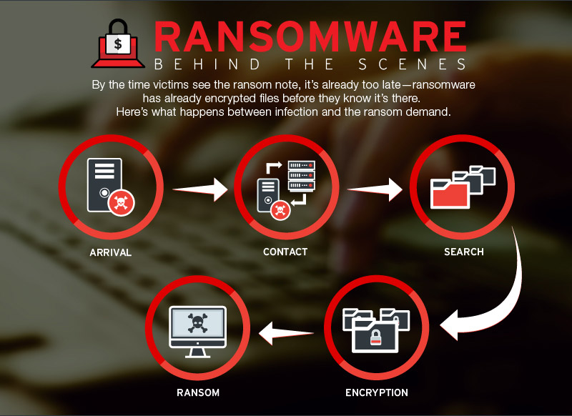
Types
There are two main types of ransomware:
Crypto Ransomware
Locker Ransomware

Slide 8
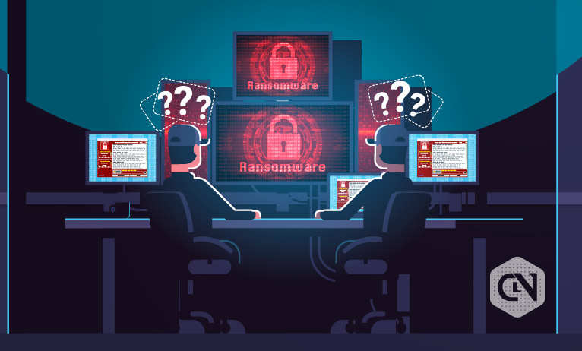
Crypto Ransomware
Crypto ransomware encrypts valuable files on a computer so that the user cannot access them.
Cyberthieves that conduct crypto ransomware attacks make money by demanding that victims pay a ransom to get their files back.

Slide 9
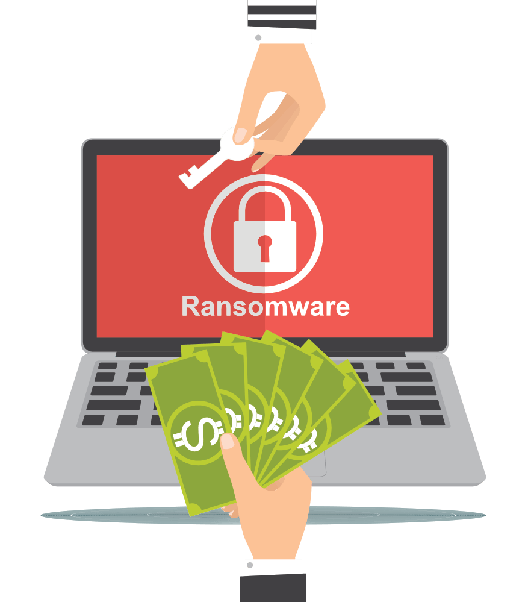
Locker Ransomware
Locker ransomware does not encrypt files. Rather, it locks the victim out of their device, preventing them from using it.
Once they are locked out, cybercriminals carrying out locker ransomware attacks will demand a ransom to unlock the device.

Slide 10
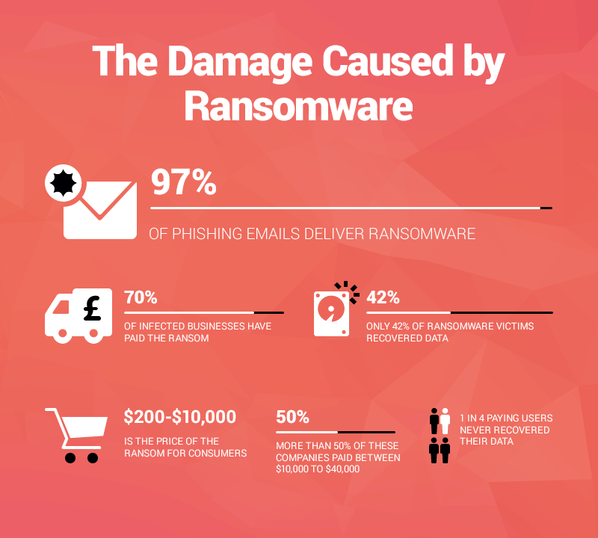
Damage by Ransomware

Slide 11


Bitcoin
Bitcoin is a cryptocurrency.
It is a decentralized digital currency without a central bank or single administrator that can be sent from user to user on the P2P bitcoin network without the need for intermediaries.
The first ever Bitcoin was created by Satoshi Nakamoto on 31 October 2008

Slide 12

Top Ransomwares attacks in History
WannaCry
Ryuk
CryptoLocker
Petya
Bad Rabbit

Slide 13

1. WannaCry
WannaCry is ransomware attack that spread across 150 countries in 2017.
Designed to exploit a vulnerability in Windows, it was allegedly created by the United States National Security Agency and leaked by the Shadow Brokers group.
WannaCry affected 230,000 computers globally.
The attack hit a third of hospital trusts in the UK, costing the NHS an estimated £92 million. Users were locked out and a ransom was demanded in the form of Bitcoin.
The cybercrime caused an estimated $4 billion in financial losses worldwide.

Slide 14
2. Ryuk
Ryuk ransomware, which spread in August 2018, disabled the Windows System Restore option, making it impossible to restore encrypted files without a backup.
Ryuk also encrypted network drives.
The effects were crippling, and many organizations targeted in the US paid the demanded ransoms
August 2018 reports estimated funds raised from the attack were over $640,000.

Slide 15
3. CryptoLocker
CryptoLocker is ransomware that was first seen in 2007 and spread through infected email attachments.
Once on your computer, it searched for valuable files to encrypt and hold to ransom.
Thought to have affected around 500,000 computers, law enforcement and security companies eventually managed to seize a worldwide network of hijacked home computers that were being used to spread Cryptolocker.
CryptoLocker then after released a Master Key for all victims.

Slide 16

4. Petya
Petya (not to be confused with ExPetr) is a ransomware attack that first hit in 2016 and resurged in 2017 as GoldenEye.
Rather than encrypting specific files, this vicious ransomware encrypts the victim’s entire hard drive.
It does this by encrypting the Master File Table (MFT) making it impossible to access files on the disk.
Petya spread through HR departments via a fake job application email with an infected Dropbox link.

Slide 17

5. Bad Rabbit
Bad Rabbit is a 2017 ransomware attack that spread using a method called a ‘drive-by’ attack, where insecure websites are targeted and used to carry out an attack.
During a drive-by ransomware attack, a user visits a legitimate website, not knowing that they have been compromised by a hacker.
Drive-by attacks often require no action from the victim, beyond browsing to the compromised page. However, in this case, they are infected when they click to install something that is actually malware in disguise.
It is different from NotPetya in the way it spreads. For the Bad Rabbit ransomware to be “activated,” visitors need to install a false Adobe Flash update.

Slide 18

Tips to prevent Ransomware
There are a number of defensive steps you can take to prevent ransomware infection.
Keep your operating system patched and up-to-date to ensure you have fewer vulnerabilities to exploit.
Don't install software or give it administrative privileges unless you know exactly what it is and what it does.
Install antivirus software, which detects malicious programs like ransomware as they arrive, and whitelisting software, which prevents unauthorized applications from executing in the first place.
And, of course, back up your files, frequently and automatically!

Slide 19

Thank You

Slide 20

Be Safe

